Slide 1
Lecture 13 do … while loops

Slide 2
C do...while loops
In C, do...while loop is very similar to while loop.
Only difference between these two loops is that, in while loops, test expression is checked at first
But, in do...while loop code is executed at first then the condition is checked.
So, the code are executed at least once in do...while loops.

Slide 3
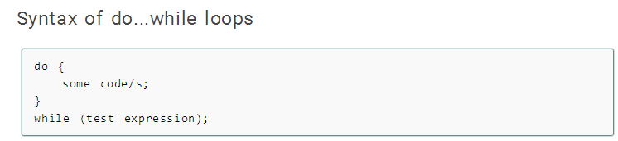
Syntax of do … while loops

Slide 4
Explanation:
At first codes inside body of do is executed.
Then, the test expression is checked.
If it is true, code/s inside body of do are executed again
The process continues until test expression becomes false(zero).
Notice, there is semicolon in the end of while (); in do...while loop.

Slide 5
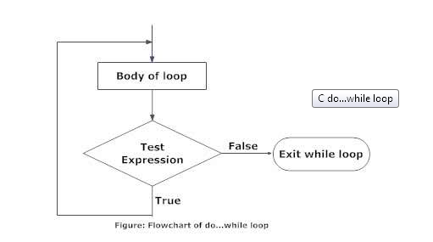
Flowchart of do … while loops

Slide 6
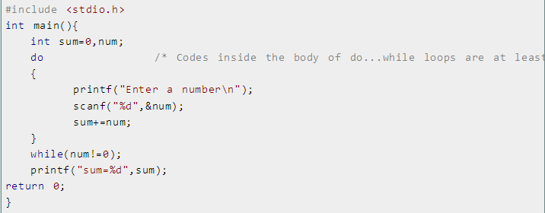
Let us consider an example:
Write a C program to add all the numbers entered by a user until user enters 0.

Slide 7
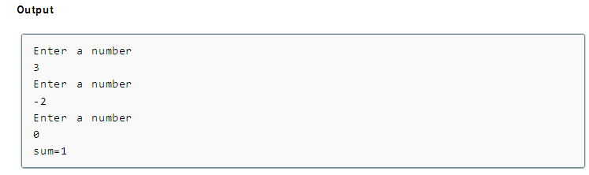
In this C program, user is asked a number and it is added with sum.
Then, only the test condition in the do...while loop is checked.
If the test condition is true,i.e, num is not equal to 0, the body of do...while loop is again executed until num equals to zero.

Slide 8
Let’s Review what we have learned so far:
In do… while the condition is tested at the end of the block instead of the beginning, so the block will be executed at least once.
If the condition is true, we jump back to the beginning of the block and execute it again.
A do..while loop is almost the same as a while loop except that the loop body is guaranteed to execute at least once.
A while loop says "Loop while the condition is true, and execute this block of code",
A do..while loop says "Execute this block of code, and then continue to loop while the condition is true".

Slide 9
Let us consider another example:
#include <stdio.h>
int main()
{
int x;
x = 0;
do {
/* "Hello, world!" is printed at least one time even though the condition is false */
printf( "Hello, world!\n" );
}
while ( x != 0 );
return 0;
}

Slide 10
Caution!!!!!!!!
Keep in mind that you must include a trailing semi-colon after the while in the above example.
A common error is to forget that a do..while loop must be terminated with a semicolon (the other loops should not be terminated with a semicolon, adding to the confusion).
Notice that this loop will execute once, because it automatically executes before checking the condition.

